Slide 1
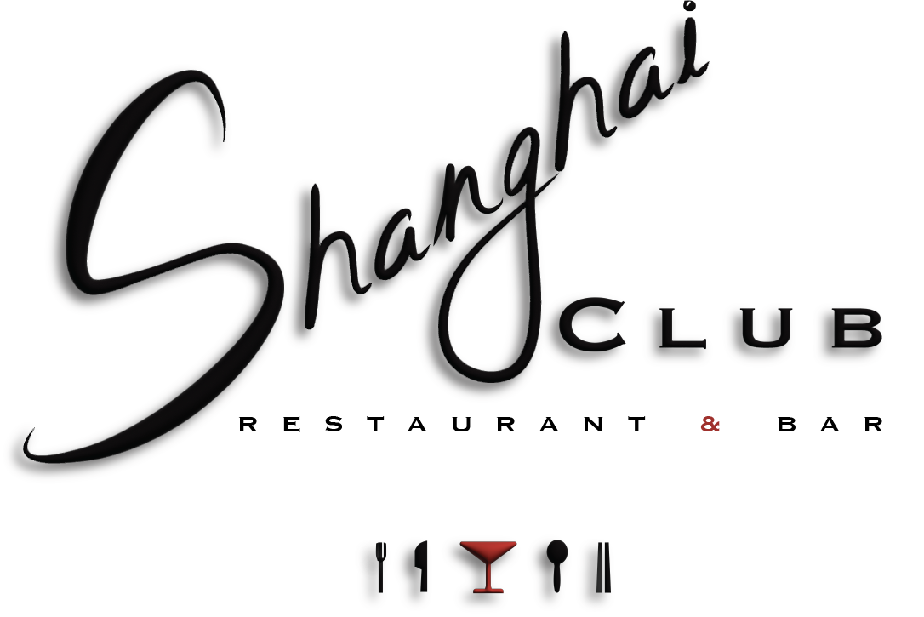
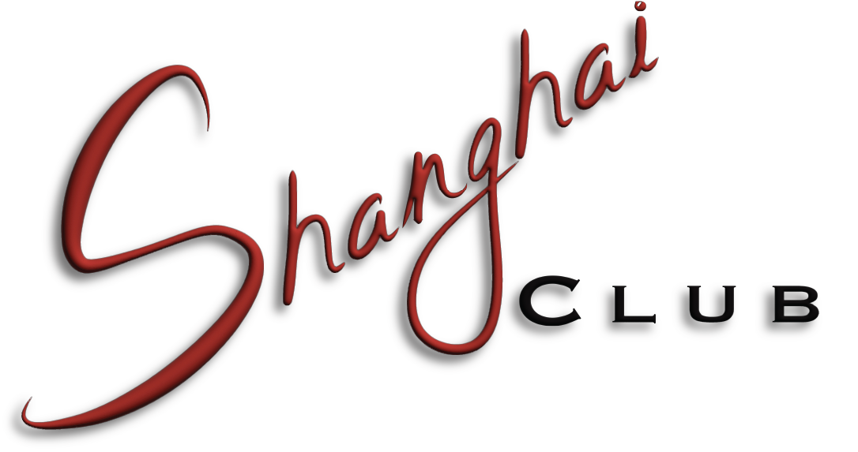
D R I N K S
w w w .s h a n g h a I c l u b . s y d n e y

Slide 2
Champagne NV Laurent Perrier La Cuvee | Ay, Franc | $29
Sparkling
NV Secret Garden NV Delamere Sparkling Brut | Murray River, NSW Pipers Brook, TAS | $11 $18
White
2024 Secret Garden Pinot Gris 2023 Jules Taylor Sauvignon Blanc | Murray River, NSW Malborough, NZ | $10 $15
2023 Clandestine Pinot Gris | King Valley, SA | $16
2023 Kilikanoon Killerman's Run Riesling 2024 Secret Garden Chardonnay | Clare Valley, SA Murray River, NSW | $15 $10
2022 Allandale Chardonnay | Hunter Valley, NSW | $15
Rose
2023 La Tonelle Provence Rose | Cotes de Provence, FR | $15
2022 Chain of Ponds Innocence | Adelaide Hills, SA | $14
Red
2023 Holm Oak Pinot Noir | Tamar Valley, TAS | $16
2020 Budburst Shiraz | Barossa Valley, SA | $15
2021 Elderton Estate Shiraz 2024 Secret Garden Shiraz | Barossa Valley, SA Murray River, NSW | $19 $11
2022 Rosily Cabernet Sauvignon | Margaret River, WA | $16
Dessert
2015 Trentham Estate Noble Taminga | Murray Darling , NSW | $10
B E E R & C I D E R
I M P O R T E D
Peroni 10
Italian pale lager, crisp, refreshing
Asahi 12
Japanese rice lager, clean, dry
Heineken 11
Dutch pale lager, balanced, smooth
Corona 12
Mexican pale lager, light, lime-friendly
Sol 10
Mexican pale lager, light, effervescent
L O C A L
Wayward Brewing IPA 12
James Squire Lager 12
G I N G E R B E E R
Young Henry’s ginger Beer 11
Royal Jamaican Ginger Beer 12
p4
p3

Slide 3
S I G N A T U R E C O C K T A I L S
V O D K A
G I N
Mango Royale 21
Closer to melted ice cream than a martini, cream and mango
liqueur combine to create a sweet and indulgent mix.
Hotel Shanghai: 23
A classic tiki cocktail re-imagined with punchy single origin
Japanese plum wine
Yuzu Pearl Martini: 20
A refreshingly fruity yet sophisticated martini incorporating Japanese
Shochu and Yuzu liqueur.
Pear Charlie Chaplin 23
A time-favoured classic with depth and complexity, punched up with a
blend of apricot and spiced pear.
Lychee Pisco Sour 21
A dangerously good combination of lychee notes and Pisco, the perfect
start to a night out.
Smokey Plum Negroni 24
Salted plum gin and mezcal combine perfectly to provide something
new for negroni lovers.
Shanghai’d 22
An incredibly approachable yet boozy drink incorporating rum and classic tiki
flavours.
Classic Cocktails available, please request.
House Vodka 9.5
Belvedere Vodka 12
Polish – 100% Rye
Grey Goose Vodka 12
French – 100% Wheat
House Gin 10
Green Ant Gin 14
Australian, Citric, Floral
Archie Rose Straight Dry 11
Australian, Dry, Peppery
Archie Rose Signature 14
Australian, Herbal, Citric
Four Pillars Bloody Shiraz 14
Australian, Shiraz Grapes
Husk Sloe Gin 12
Australian, Sloe Berry, Liquorice
Peddler’s Salted Plum Gin 13
Chinese, Intense, Fruity
AMERICAN WHISKEY
House Bourbon 10
Jack Daniels Old No.7 22
Lynchburg Tennessee
Sazerac Rye 14
Kentucky
SCOTCH
House Scotch 10
Chivas Regal Extra 13 YO 14
Tequila Cask Finish - Speyside
GlenDronach 12 YO 18
PX & Sherry Casks - Highlands
RUM
M O C K T A I L S 14
Passion Fizz
A refreshing fruity drink that’s the perfect non-alcoholic
drink to end the day
Tropic Thunder
A tiki mocktail that brings the beach to you
Bati Spiced or White Rum 11
Fijian, Barrel Aged, 2 YO
Kraken Spiced Rum 12
Spiced Caribbean Rum
Appleton Estate Signature 15
Jamaican, Barrel Aged, 4 YO
Please add $2 for your preferred mixer
p2
p5

Slide 4
TEQUILA/AGAVE
SPECIALTY
Cazadores Blanco Tequila 11
100% Blue Agave, Unaged
Patron Silver 14
100% Blue Agave, Unaged
Del Maguey Vida Mezcal 13
Family Owned, Smokey
Koyomi Shochu 12
Japanese, Miyazaki Prefecture
Tiny Friday Pisco 14
Australian Muscat Pisco
B A R S N A C K S
Cognac/Armonac
Pistachio Nuts in Shell 7
Roasted Saltd Peanuts skin on 3
HOTEL SHANGHAI 22
Af b db dfb dsb db
HOTEL SHANGHAI 22
Af b db dfb dsb db
HOTEL SHANGHAI 22
Af b db dfb dsb db
HOTEL SHANGHAI 22
Af b db dfb dsb db
Classic Cocktails
Raymond Ragnaud Selection 14
Cognac, 4YO Select
Chateau de Laubade VSOP 16
Sorbet Armagnac, 6-12YO
P O R T S H E R R Y D I G E S T I V E S
HOTEL SHANGHAI 22
Af b db dfb dsb db
HOTEL SHANGHAI 22
Af b db dfb dsb db
HOTEL SHANGHAI 22
Af b db dfb dsb db
HOTEL SHANGHAI 22
Af b db dfb dsb db
Classic Cocktails
Fernet Branca 11
Herbal Italian Amaro
Autonomy Bitter Limencello 10
Australian Limencello
Please add $2 for your preferred mixer
p6
p7

